Slide 1

Master Theorem Application Analysis of the Recurrence Relation
T(n) = 2T(n/2) + n
CSA0608-Design and Analysis of Algorithm
Guided By:
Dr. P. Sriramya
Presented By:
K. A. Analiya(192521395)

Slide 2


INTRODUCTION
Master Theorem is a mathematical technique used to determine the time complexity of Divide and Conquer algorithms without solving recurrence relations manually.
It is mainly applied to recurrences of the form
T(n)= aT(n/b)+f(n)
Where,
a = Number of subproblems
b = Reduction factor
f(n) = Cost outside recursion
Applications:
Merge Sort
Binary Search
Quick Sort (Average Case)
Strassen Matrix Multiplication

Slide 3
PROBLEM STATEMENT
Analyze the recurrence relation
T(n) = 2T(n/2) + n
using the Master Theorem.
The objective is to:
Identify the values of a and b.
Determine the function f(n).
Compare f(n) with n^(log_b a).
Identify the applicable case of the Master Theorem.
Find the final asymptotic time complexity.
Verify the result using a Recursion Tree and implementation.

Slide 4
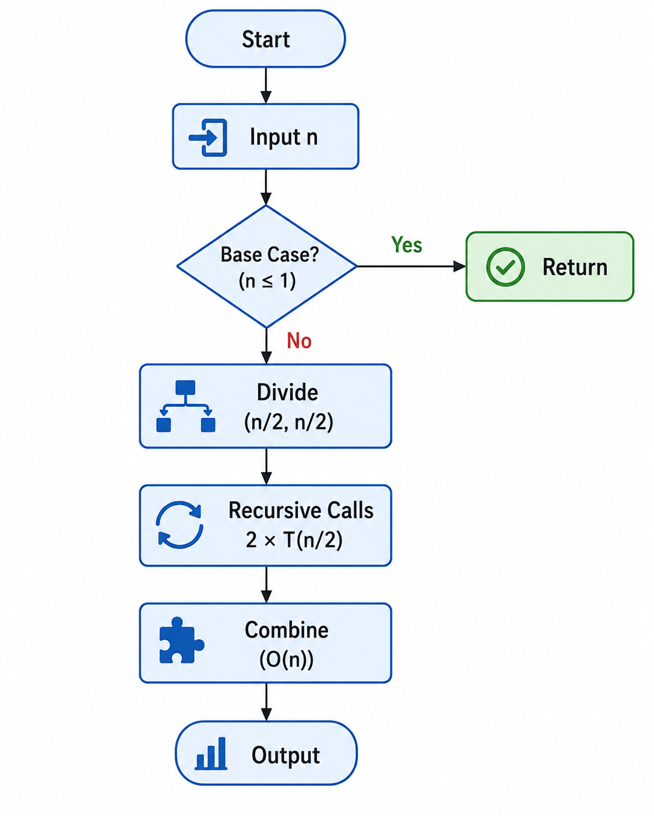
SYSTEM ARCHITECTURE

Slide 5
ALGORITHM / PSEUDOCODE
Algorithm
Read the input size n.
Check whether n ≤ 1.
If true, return (Base Case).
Divide the problem into two equal subproblems.
Solve each subproblem recursively.
Perform the combine operation requiring O(n) work.
Return the final result.
interpret the algorithm's efficiency.
Pseudocode
Algorithm Master Theorem(n)
if n <= 1
return
Master Theorem (n/2)
Master Theorem (n/2)
Perform Combine Operation
return
returnefficiency.

Slide 6
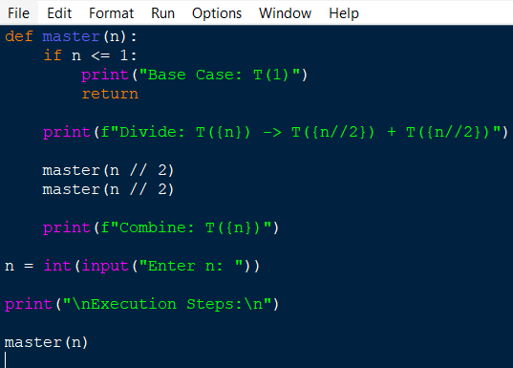
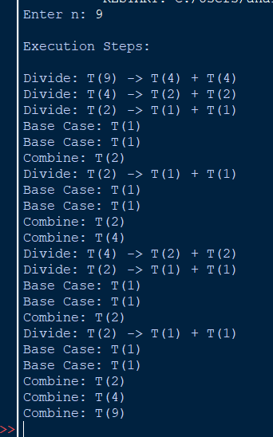
IMPLEMENTATION / OUTPUT
Observation:
The problem is repeatedly divided into smaller subproblems.
Once the base case is reached, the results are combined.
This demonstrates the Divide and Conquer approach.

Slide 7
TIME COMPLEXITY ANALYSIS
Applying the Master Theorem
Given:
T(n) = 2T(n/2) + n
Step 1: Identify Parameters
a = 2
b = 2
f(n) = n
Step 2: Compute
log₂2 = 1
Therefore,
n^(log₂2) = n
Step 3: Compare
f(n) = n
n^(log₂2) = n
Since both are equal,
Applicable Case
Master Theorem – Case 2
Final Time Complexity
T(n) = Θ(n log n)

Slide 8
CONCLUSION
Master Theorem simplifies the analysis of recurrence relations.
The recurrence T(n) = 2T(n/2) + n follows the Divide and Conquer strategy.
Here, a = 2, b = 2, and f(n) = n.
Since f(n) = Θ(n^(log_b a)), the recurrence satisfies Case 2 of the Master Theorem.
Therefore, the overall time complexity is:
Θ(n log n)
This complexity is efficient and is also observed in algorithms like Merge Sort.

Slide 9
THANK
YOU!....

